Slide 1
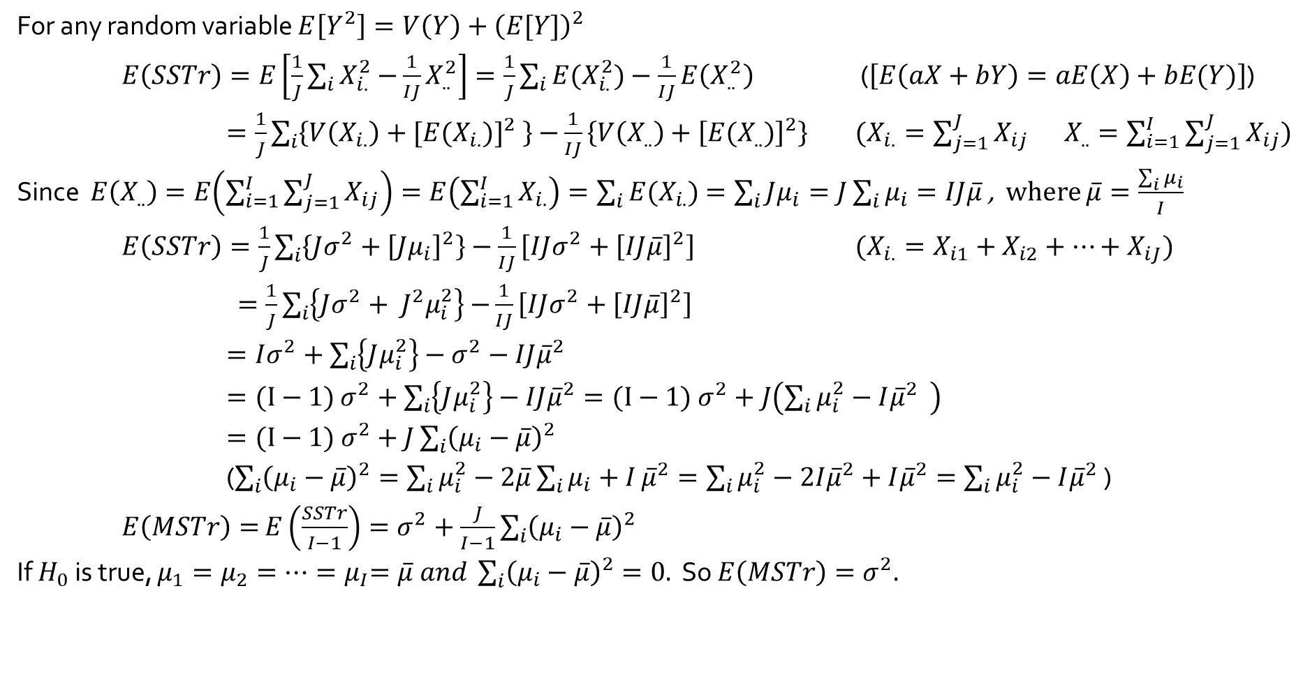
$E\left(MSTr\right)=σ^{2}$ if $H_{0}$ is true
For any random variable $E\left[Y^{2}\right]=V\left(Y\right)+{\left(E[Y]\right)}^{2}$
$E\left(SSTr\right)=E\left[\frac{1}{J}\sum_{i}{X_{i.}^{2}−}\frac{1}{IJ}X_{..}^{2}\right]=\frac{1}{J}\sum_{i}{{E(X}_{i.}^{2})}−\frac{1}{IJ}E\left(X_{..}^{2}\right)$ ($\left[E\left(aX+bY\right)=aE\left(X\right)+bE(Y)\right]$)
$=\frac{1}{J}\sum_{i}{\left\{V\left(X_{i.}\right)+[{E(X_{i.})]}^{2} \right\}−}\frac{1}{IJ}\left\{V\left(X_{..}\right)+{\left[E(X_{..})\right]}^{2}\right\}$ ($X_{i.}=\sum_{j=1}^{J}{X_{ij}}$ $X_{..}=\sum_{i=1}^{I}{\sum_{j=1}^{J}{X_{ij}}}$)
Since $E\left(X_{..}\right)=E\left(\sum_{i=1}^{I}{\sum_{j=1}^{J}{X_{ij}}}\right)=E\left(\sum_{i=1}^{I}{X_{i.}}\right)=\sum_{i}{E(X_{i.})}$ $=\sum_{i}{Jμ_{i}}=J\sum_{i}{μ_{i}}=IJ\overline{μ}$ , where $\overline{μ}=\frac{\sum_{i}{μ_{i}}}{I}$
$E\left(SSTr\right)=\frac{1}{J}\sum_{i}{\left\{Jσ^{2}+{\left[Jμ_{i}\right]}^{2}\right\}}−\frac{1}{IJ}\left[IJσ^{2}+{\left[IJ\overline{μ}\right]}^{2}\right]$ ($X_{i.}=X_{i1}+X_{i2}+⋯+X_{iJ})$
$=\frac{1}{J}\sum_{i}{\left\{Jσ^{2}+ J^{2}μ_{i}^{2}\right\}}$ $−\frac{1}{IJ}\left[IJσ^{2}+{\left[IJ\overline{μ}\right]}^{2}\right]$
$=Iσ^{2}+\sum_{i}{\left\{Jμ_{i}^{2}\right\}}−σ^{2}−IJ{\overline{μ}}^{2}$
$=(I−1)$ $σ^{2}+\sum_{i}{\left\{Jμ_{i}^{2}\right\}}−IJ{\overline{μ}}^{2}=(I−1) σ^{2}+J\left(\sum_{i}{μ_{i}^{2}}−I{\overline{μ}}^{2} \right)$
$=(I−1) σ^{2}+J\sum_{i}{{\left(μ_{i}−\overline{μ}\right)}^{2}}$
($\sum_{i}{{\left(μ_{i}−\overline{μ}\right)}^{2}}=\sum_{i}{μ_{i}^{2}}−2\overline{μ}\sum_{i}{μ_{i}+I}{\overline{μ}}^{2}=\sum_{i}{μ_{i}^{2}}−2I{\overline{μ}}^{2}+I{\overline{μ}}^{2}=\sum_{i}{μ_{i}^{2}}−I{\overline{μ}}^{2}$ )
$E\left(MSTr\right)=$ $E\left(\frac{SSTr}{I−1}\right)=σ^{2}+\frac{J}{I−1}\sum_{i}{{\left(μ_{i}−\overline{μ}\right)}^{2}}$
If $H_{0}$ is true, $μ_{1}=μ_{2}=⋯{=μ}_{I}=\overline{μ} and \sum_{i}{{\left(μ_{i}−\overline{μ}\right)}^{2}}=0.$ So $E\left(MSTr\right)=σ^{2}.$

Slide 2
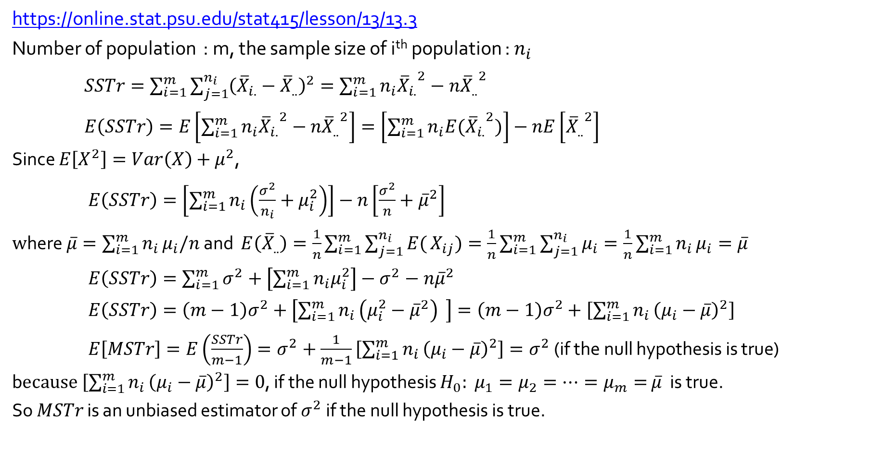
Theoretical Results | Stat 414/415 – Statistics Online – Penn State
https://online.stat.psu.edu/stat415/lesson/13/13.3
Number of population : m, the sample size of i^{th} population : $n_{i}$
$SSTr=\sum_{i=1}^{m}{\sum_{j=1}^{n_{i}}{{\left({\overline{X}}_{i.}−{\overline{X}}_{..}\right)}^{2}}}=\sum_{i=1}^{m}{n_{i}{{\overline{X}}_{i.}}^{2}}−n{{\overline{X}}_{..}}^{2}$
$E\left(SSTr\right)=E\left[\sum_{i=1}^{m}{n_{i}{{\overline{X}}_{i.}}^{2}}−n{{\overline{X}}_{..}}^{2}\right]=\left[\sum_{i=1}^{m}{n_{i}{{E(\overline{X}}_{i.}}^{2})}\right]−nE\left[{{\overline{X}}_{..}}^{2}\right]$
Since $E\left[X^{2}\right]=Var\left(X\right)+μ^{2}$,
$E\left(SSTr\right)=\left[\sum_{i=1}^{m}{n_{i}\left(\frac{σ^{2}}{n_{i}}+μ_{i}^{2}\right)}\right]−n\left[\frac{σ^{2}}{n}+{\overline{μ}}^{2}\right]$
$w$here $\overline{μ}=\sum_{i=1}^{m}{n_{i}}μ_{i}/n$ and $E\left({\overline{X}}_{..}\right)=\frac{1}{n}\sum_{i=1}^{m}{\sum_{j=1}^{n_{i}}{E(}}X_{ij})=\frac{1}{n}\sum_{i=1}^{m}{\sum_{j=1}^{n_{i}}{μ_{i}}}=\frac{1}{n}\sum_{i=1}^{m}{n_{i}}μ_{i}=\overline{μ}$
$E\left(SSTr\right)=\sum_{i=1}^{m}{σ^{2}}+\left[\sum_{i=1}^{m}{n_{i}μ_{i}^{2}}\right]−σ^{2}−n{\overline{μ}}^{2}$
$E\left(SSTr\right)=\left(m−1\right)σ^{2}+\left[\sum_{i=1}^{m}{n_{i}}\left(μ_{i}^{2}−{\overline{μ}}^{2}\right) \right]=\left(m−1\right)σ^{2}+\left[\sum_{i=1}^{m}{n_{i}}{\left(μ_{i}−\overline{μ}\right)}^{2}\right]$
$E\left[MSTr\right]=E\left(\frac{SSTr}{m−1}\right)=σ^{2}+\frac{1}{m−1}\left[\sum_{i=1}^{m}{n_{i}}{\left(μ_{i}−\overline{μ}\right)}^{2}\right]=σ^{2}$ (if the null hypothesis is true)
b$ecause \left[\sum_{i=1}^{m}{n_{i}}{\left(μ_{i}−\overline{μ}\right)}^{2}\right]=0$, if the null hypothesis $H_{0}:$ $μ_{1}=μ_{2}=⋯=μ_{m}=$ $\overline{μ}$ is true.
So $MSTr$ is an unbiased estimator of $σ^{2}$ if the null hypothesis is true.

